Slide 1
Cyclone Prediction using Machine Learning
K.Theja Shree(1601-13-737-026)

Slide 2
Contents
Problem Statement
System and Software Specifications
Literature Survey
Existing Work
Methodology
Data Cleaning & Preprocessing
Algorithms
Accuracy Measures
Results
Conclusion & Limitations
Future Scope
Bibliography

Slide 3
Problem Statement
Using pressure as independent variable and wind speed as dependent we try to predict wind speed.
Categorization of cyclones.
Using data science techniques to visualize and summarize the impact of cyclones in various regions.

Slide 4
System and Software Requirements
Any operating system either windows, linux etc.
Machine learning platform-Anaconda with several packages (pandas for data cleaning and sklearn for algorithms)
Ipython- IDE for Python
Eclipse – IDE for Java

Slide 5
Eclipse
Eclipse is a widely used Integrated Development Environment and is used mainly for JAVA.
It comes with a lot of packages to support data mining ,machine learning ,data science,statistics and other advanced functions other than basic java functions.

Slide 6
Anaconda and Ipython
Anaconda:Anaconda is a open source platform of the Python and R programming languages for large-scale data processing, predictive analytics, and scientific computing, that aims to simplify package management and deployment
Ipython:The Jupyter Notebook is an IDE that allows you to create and share documents with visualizations and explanatory text. Uses include: data cleaning and transformation, numerical simulation, statistical modelling, machine learning and much more.

Slide 7
Literature Survey
Aditi Kansal Etal, ”Detection of Forest Fires using Machine Learning “,IEEE 2016.
K. Sakthi Etal,”Flood Prediction using Optimized Machine Learning Techniques”, IEEE 2016.
Youssef Safi Etal,”Prediction of Forest Fires Using Artificial Neural Networks”, IEEE 2015.
G. V. Otari Etal,”A Review of Application of Data Mining in Earthquake Prediction”, IEEE 2015.

Slide 8
Yahui Di, Wei Ding Etal,”Developing machine learning tools for long-lead heavy precipitation prediction with multi-sensor data”,IEEE 2014
Alexander L. Pyayt ,”Machine Learning Methods for Environmental Monitoring and Flood Protection”, IEEE 2014
Washington Okori Etal, ”Machine Learning Classification Technique for Famine Prediction “, IEEE 2013

Slide 9
Existing Work
Present solutions use either pressure or wind speed to predict cyclones.
Present solution incorporates neural networks.
No data visualization available in the form of easily identifiable graphs .

Slide 10
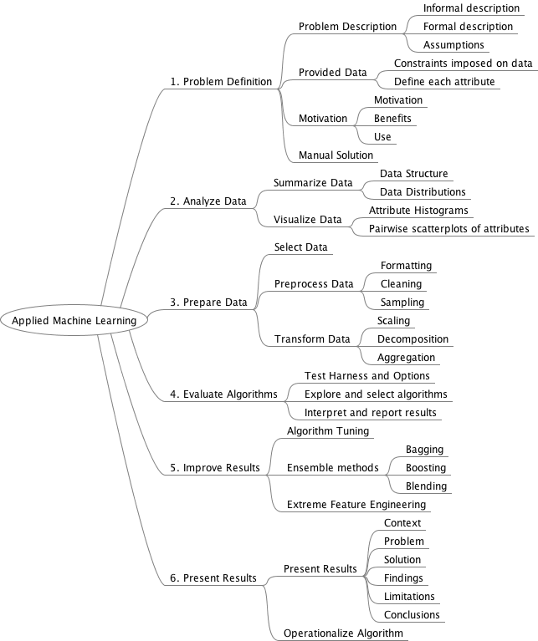
Methodology

Slide 11
Block Diagram of problem statement 1
Calculating accuracy measures
Prepare data : Pre-processing & Normalization to get better results
Problem definition1 Prediction of wind speed
Applying time series forecasting Algorithms.
Analyzing results

Slide 12
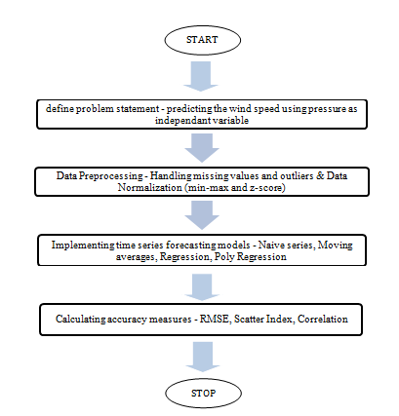
Fig : Flow Chart for module 1

Slide 13
Block diagram for problem statement 2:
Problem Statement 2:
Categorization of cyclone
Find max wind speed in each station
Compare with the predefined wind speed ranges
Categorize the type of cyclone

Slide 14
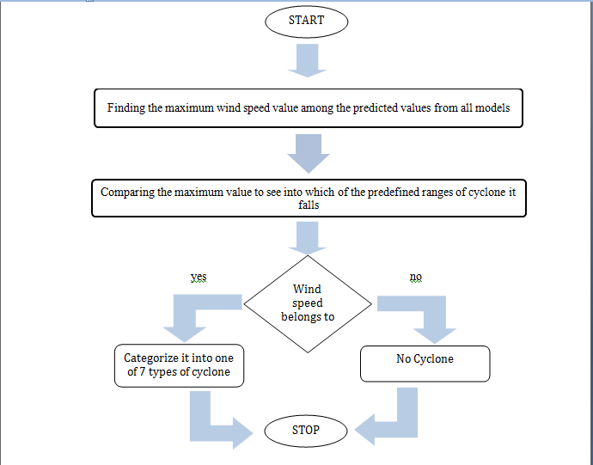
Fig : Flow Chart for module 2

Slide 15
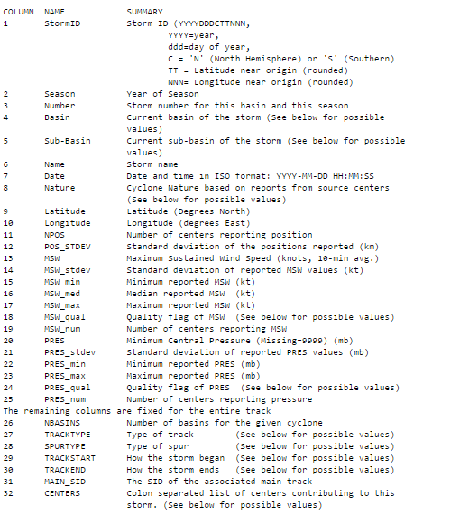
Attributes in the Dataset:
Source : NOAA

Slide 16
Data Cleaning:
Removing unnecessary attributes
Fixing Formats
Filling missing values
Correcting outliers

Slide 17


Normalization
Process of scaling down the values into a range
Min-max normalization
Z-score normalization

Slide 18
Algorithms
Time Series Forecasting Technique:
Useful when historical data exists for forecast variable
and the data exhibits a pattern.
Time Series Forecasting models-:
Naive forecast.
Period Moving Average.
Linear regression.
4th order polynomial regression
ARIMA

Slide 19
Naive forecast
Simplest possible forecast .
Naïve is the basis for comparison of all methods.
A naive forecasting model is a special case of the moving average forecasting model where the number of periods used for smoothing is 1.

Slide 20
Period Moving Average
The value for a given time period is replaced by the mean of that value and the values for some number of preceding and succeeding time periods
Pick the last n periods that are most relevant
F_{i+1} = (1/n) (S_{Ai} ) where
F_{i+1} = the forecast for next period
n = the number of periods in the moving average
(S_{Ai} ) = the sum of the last n periods

Slide 21
Linear regression
A single variable linear regression model essentially attempts to put a straight line through the data points.
y = intercept + slope * x

Slide 22
4th order polynomial regression
A single variable polynomial regression model essentially attempts to put a polynomial line - a curve if you prefer - through the data points.
y = a₀ + a₁*x + a₂*x² + a₃*x³ + ... + a_{m}*x^{m}

Slide 23
ARIMA
Auto Regressive Integrated Moving Averages forecasting for a stationary time series is nothing but a linear (like a linear regression) equation. The predictors depend on the parameters (p,d,q) of the ARIMA model:
Number of AR (Auto-Regressive) terms (p)
Number of MA (Moving Average) terms (q)
Number of Differences (d)

Slide 24
Accuracy Measures
Scatter Index
RMSE-Root Mean Square Error
Correlation

Slide 25
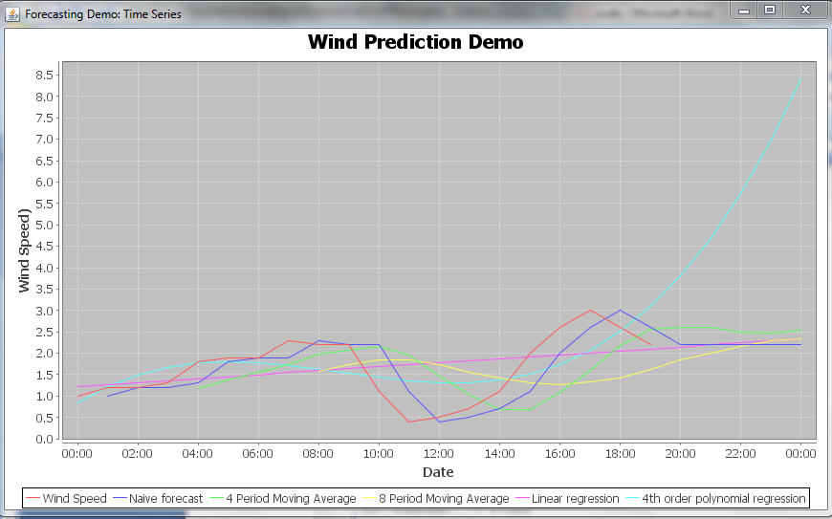
Results
Fig : Chart denoting trends of various forecasting algorithms

Slide 26
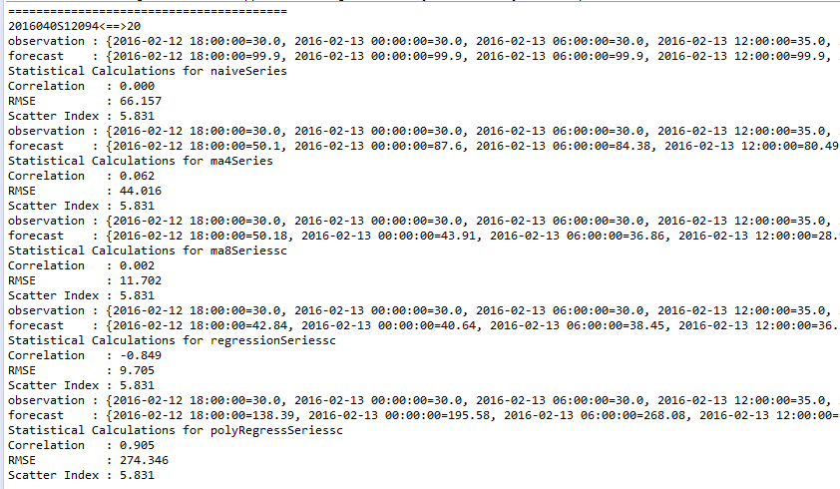
Fig shows metrics RMSE, Correlation and Scatter Index for station with id 2016040S12094

Slide 27
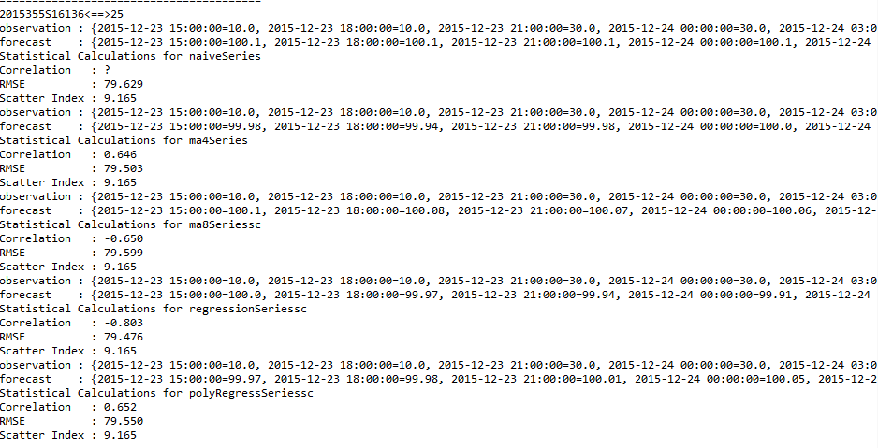
Fig shows metrics RMSE, Correlation and Scatter Index for station with id 2015355S16136

Slide 28
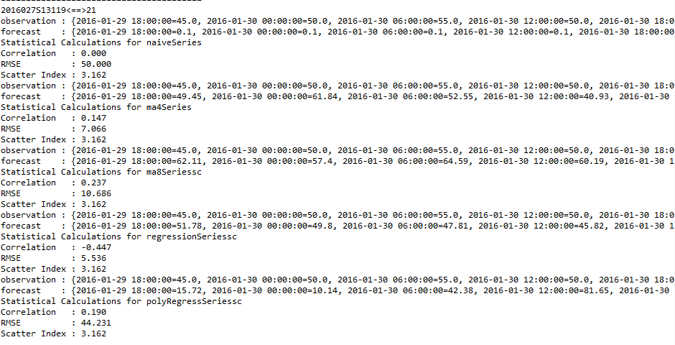
Fig shows metrics RMSE, Correlation and Scatter Index for station with id 2016027S13119

Slide 29
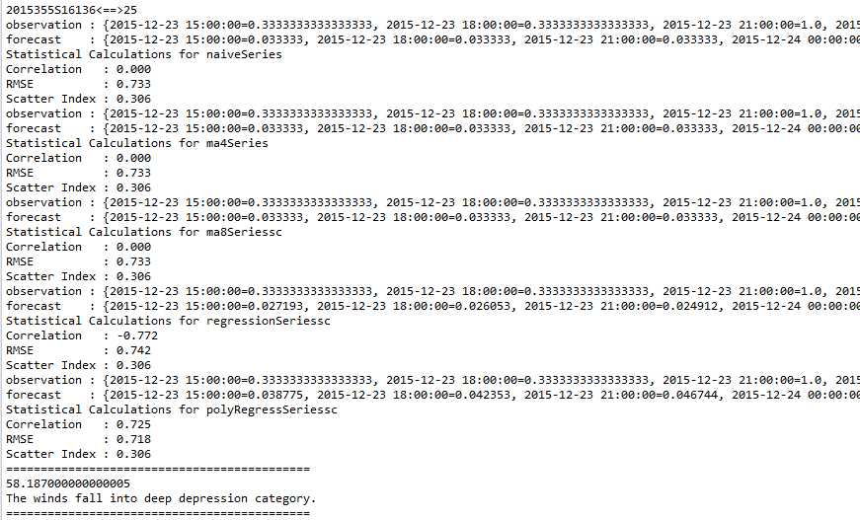
Fig shows improved values of metrics after min-max normalization for station 2015355S16136

Slide 30
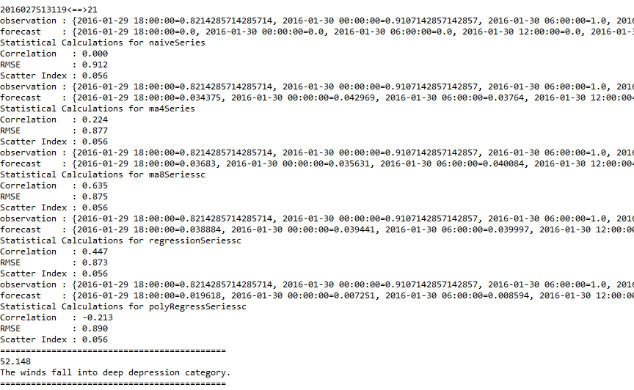
Fig shows improved values of metrics after min-max normalization for station 2016027S13119

Slide 31
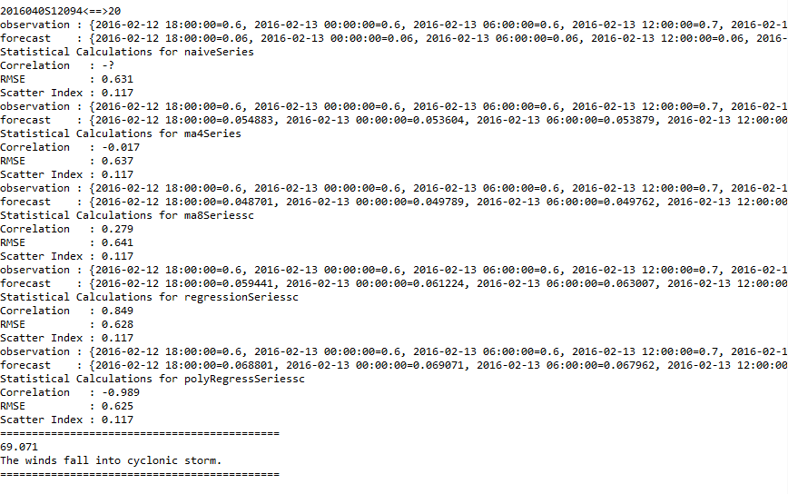
Fig showing improved values of metrics after min-max normalization for station 2016040S12094

Slide 32
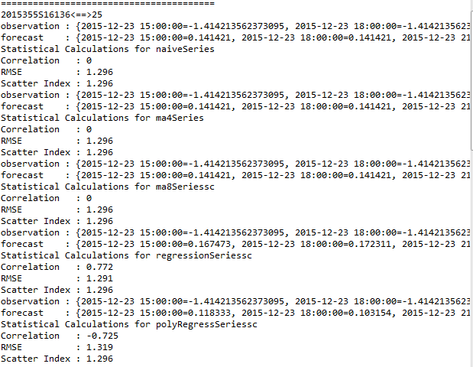
Fig showing improved values of metrics after z-score normalization for station 2015355S16136

Slide 33
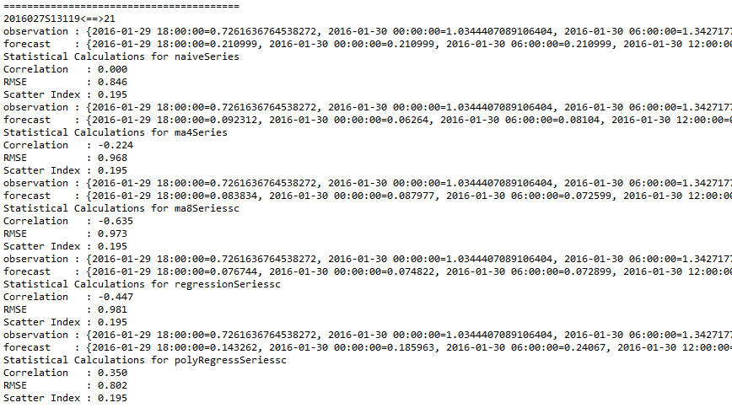
Fig shows improved values of metrics after z-score normalization for station 2016027S13119

Slide 34
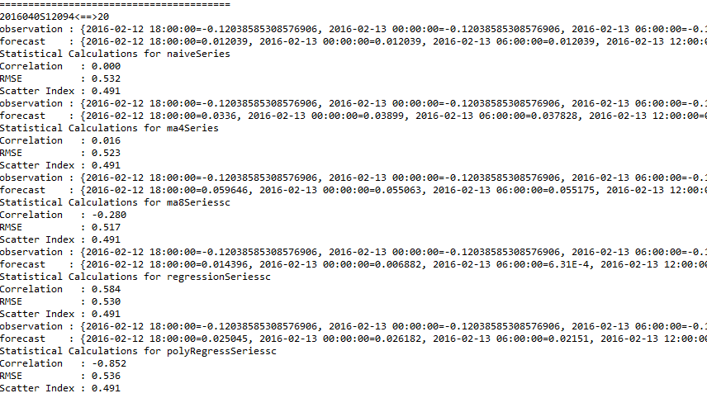
Fig shows improved values of metrics after z-score normalization for station 2016040S1209

Slide 35
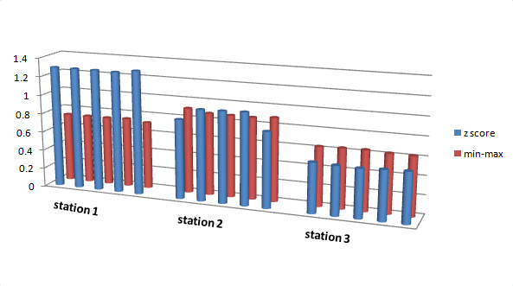
Chart showing comparison between RMSE values obtained from min-max and z-score normalization

Slide 36
Station ID | Min-max | Z-score
1 | Poly Regression | Regression
2 | Moving Average 8 | Poly Regression
3 | Regression | Regression
Table shows the best model in the particular station basing on RMSE and correlation

Slide 37
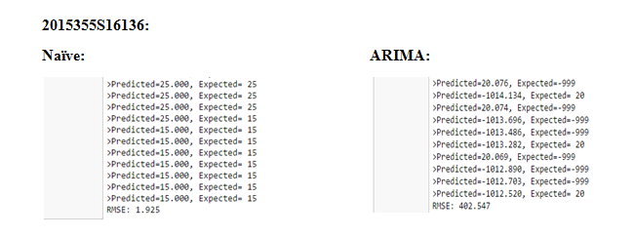
Fig shows persistence and ARIMA models with RMSE values for station 2015355S16136

Slide 38
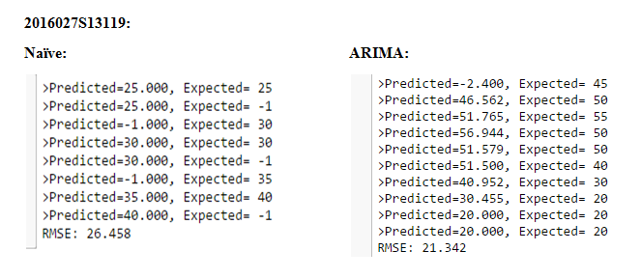
Fig shows persistence and ARIMA models with RMSE values for station 2016027S13119

Slide 39
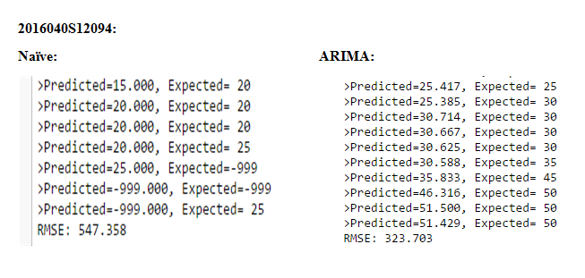
Fig shows persistence and ARIMA models with RMSE values for station 2016040S12094

Slide 40
Categorization
>31 & <50 – Depression
>51 & <62 – Deep Depression
>63 & <88 – Cyclonic Storm
>89 & <117 – Severe Cyclonic Storm
>118 & <165 – Very Severe Cyclonic Storm
>166 & <220 – Extremely Severe Cyclonic Storm
>221 – Super Cyclonic Storm

Slide 41
Station Id | Min-Max | Z-score
2015355S16136 | deep depression category | extremely severe cyclonic storm
2016027S13119 | deep depression category | super cyclonic storm
2016040S12094 | cyclonic storm | deep depression category
Table shows the cyclone categories that resulted in the 3 stations in both normalization cases

Slide 42
Conclusion
Consider both RMSE values and correlation values that are calculated.
For any model that works best, RMSE values will be less and correlation (i.e. correlation between predicted and observed values) should be near to 1 or equal to 1.
In majority of cases, Regression seemed to be performing better. However, Poly Regression model has given good results in two cases and so can be considered as the next best model.

Slide 43
Limitations
Haven’t used information regarding latitudes and longitudes in forecasting process.
Though min-max normalization seems to be giving better results, there is one exception in one station.
Though Regression is identified as best model, doesn’t give best results in all cases.

Slide 44
Future Scope
Extend the project to other disasters.
We could connect our results to any of the IOT device.
We could also integrate these into a mobile application so as to give updates about probabilities of occurrence to the people easily.
Including the information of latitudes and longitudes for in-depth forecast of point of occurrence of cyclone.

Slide 45
Bibliography
Yahui Di Etal, “Developing machine learning tools for long-lead heavy precipitation prediction with multi-sensor data”, Networking, Sensing and Control (ICNSC), 2015 IEEE 12th International Conference on 9-11 April 2015
http://www.sas.com/en_us/insights/analytics/machine-learning.html
http://media.bemyapp.com/practical-methodology-deploying-machine-learning
https://data.gov.in/catalog/number-cyclonic-stormssevere-cyclonic-storms-formed-over-north-indian-ocean
https://azure.microsoft.com/en-in/documentation/articles/machine-learning-algorithm-choice/

